Slide 1


AI Agents
Nitin Tiwari
Google Developer Expert – Machine Learning Associate Data Scientist @ Colgate-Palmolive

Slide 2
$whoami
Associate Data Scientist at Colgate-Palmolive India Ltd.
Google Developer Expert in Machine Learning
Contributor to Google Gemma Cookbook, TensorFlow.js, Google Dev Library
Technical Speaker (50+ talks across India and internationally)
Write blogs on AI/ML on Medium

Slide 3
Content
What are AI Agents? - Types of AI Agent - Architecture of a typical AI Agent
AI Agent Frameworks
Hugging Face SmolAgents
Hands-on examples with SmolAgents
Vertex AI Agent Builder
Resources

Slide 4
Evolution of LLM applications
Text Completion
Conversational Chat
Instruction Following
Vision Capabilities
AI Agents
01
02
03
04
05
Predicting and completing words, sentences in the input text sequence.
Instruction-based tasks such as text summarization, question-answering, etc.
Vision Language Models and Diffusion models (analyze content, generate images)
Perform autonomous tasks, integrate with external environments
Multi-turn conversation with context retention.

Slide 5
What are AI Agents?

Slide 6
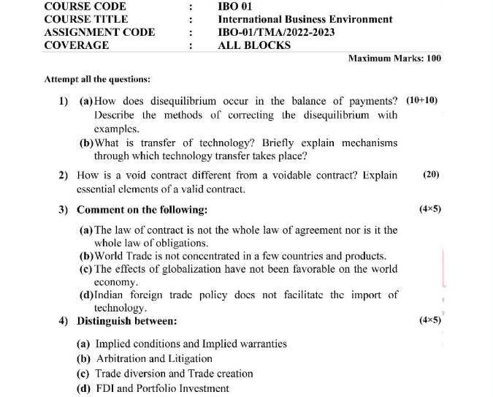
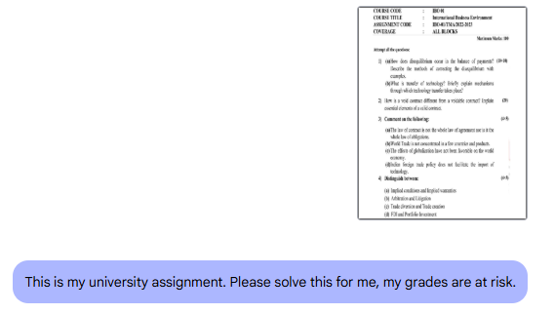
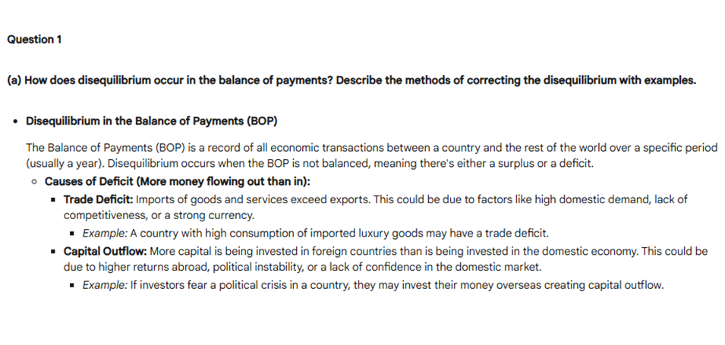
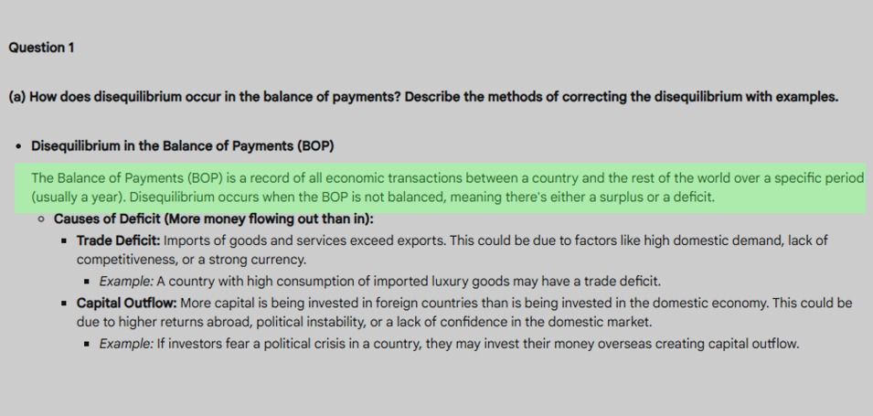
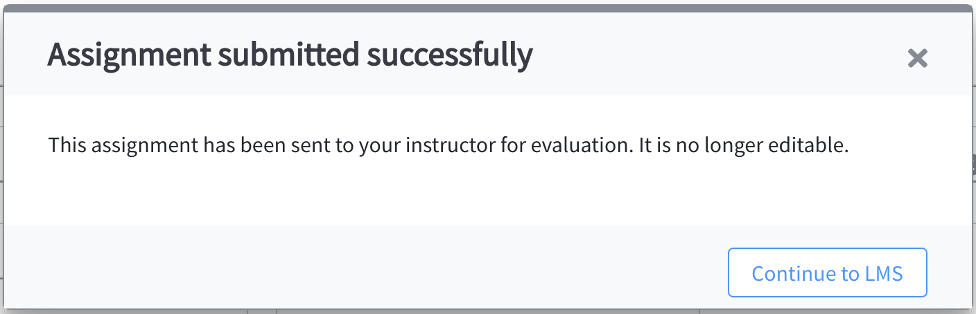
This is how you are solving assignments; I know. 🙂
Step 1: Click picture
Step 2: Upload it on Gemini/ChatGPT
Step 3: Copy the answer blindly in a .docx file
Step 4: Edit it to make it look like you did it all yourself and save as PDF
Step 5: Turn in your assignment (upload on portal or send an email to your course instructor).

Slide 7
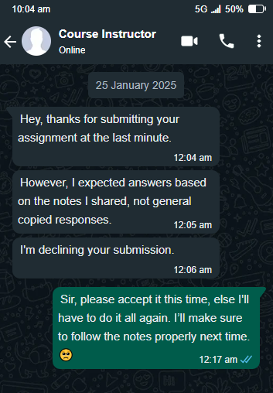

But alas…
RAG on textbook/notes
Reasoning to answer the questions
Verify the answers
Create a PDF/document
Send an email to your professor
What if you could automate all of this by having a system manage the tasks for you?
Introducing AI Agents…

Slide 8
AI Agents
AI Agents are autonomous systems designed to perform tasks or make decisions on their own, often with the help of LLMs or other AI technologies.
To build efficient systems, the LLMs must have access to the real-world data beyond its own knowledge – example: browsing the web to get external data (agency) and perform tasks.
In simple words, AI Agents are programs where LLM outputs control the workflow.
LLM
Perform tasks
Input
Output

Slide 9
Architecture of a typical AI Agent
System Prompt: “You are a meteorologist, use Python and web search to predict tomorrow’s temperature from open-source data and answer some questions.”
Memory
Prompt: “Predict tomorrow’s temperature in Chandigarh.”
LLM: Gemini, Gemma, Llama, Qwen, etc.
Memory: Stores previous responses for future reasoning.
Tools: Web browser, search engine, API calls, functions, etc.
Prompt = System Prompt + Memory
LLM
Grounding with more reliable sources of information to improve accuracy.
LLM Output: Fetching weather data, training model, searching for anomalies.
Parse tool call(s) from output
Tools
Execute Next Step
Incorrect answer
Correct answer
Final Output
Tomorrow's predicted temperature is 25°C.

Slide 10
Types of AI Agents and Agentic Systems
ReAct Agent
Code Agent
ReAct (Reasoning + Acting) iteratively plans and executes steps, based on intermediate results.
Code Agent pre-plans all the steps and generates a Python code to execute all its actions at once.
Single-agent System
Multi-agent System
A single-agent system involves only one agent that is responsible for performing tasks or making decisions in the environment.
A multi-agent system involves multiple agents that work together to solve problems.

Slide 11
Prompt: “Find and book the cheapest flights from Mumbai to Chandigarh on 25th January 2025.”
ReAct Agent
CodeAgent
Reasoning 1: I need to check for available flights from Mumbai to Chandigarh for 25th January 2025.
This agent plans all steps upfront, generates a complete Python script, and executes it in one go.
Action Step 1 : Query flight search API for flights on 25th January 2025
import requests
# Step 1: Search for flights response = requests.get("https://api.flightsearch.com/flights",
params={ "origin": "Mumbai",
"destination": "Chandigarh",
"date": "2025-01-25"
})
flights = response.json()
# Step 2: Find the cheapest flight cheapest_flight = min(flights, key=lambda x: x['price’])
# Step 3: Book the cheapest flight
booking_response = requests.post("https://api.flightsearch.com/book", json={ "flight_id": cheapest_flight["id"] })
booking = booking_response.json()
print(“Flight booked successfully.”)
Observation Step 1 : List of flights received with details (e.g., airlines, prices, timings).
Reasoning Step 2 : I need to identify the cheapest flight from the results.
Action Step 2: Process the data to find the flight with the lowest price.
Observation Step 2: Cheapest flight identified: Airline X, ₹3000, departure at 9:00 AM.
Reasoning Step 3 : I need to book this flight.
Action Step 3 : Call the booking API to reserve the flight (Airline X, ₹3000)
Observation Step 3 : Flight booked successfully on Airline X for ₹3000. Reservation code: ABC123.

Slide 12
AI Agent Frameworks

Slide 13

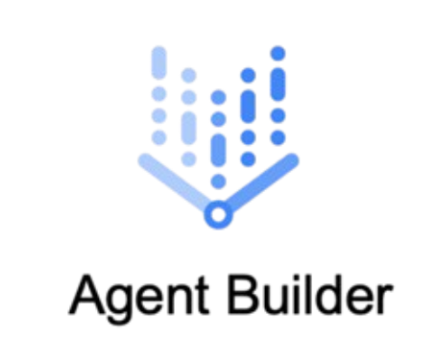



Below are some of the popular AI Agent frameworks:
Framework | Developed by | Documentation
 | Hugging Face | https://huggingface.co/docs/smolagents
 | Google | https://cloud.google.com/products/agent-builder
 | CrewAI | https://www.crewai.com/introduction
 | PydanticAI | https://ai.pydantic.dev/
 | LangChain Inc. | https://www.langchain.com/langgraph

Slide 14
Hugging Face SmolAgents

Slide 15

SmolAgents
Hugging Face’s SmolAgents is a library that enables you to run powerful agents in a few lines of code.
It uses Code Agents – agents that write Python codes to execute their actions.
Supports most of the open LLMs hosted on Hugging Face Hub as well as proprietary models like Gemini, OpenAI, Anthropic with LiteLLM integration.
Has built-in tools like DuckDuckGo search engine, as well as integration with LangChain, and HF Spaces.
How to use?
from smolagents import CodeAgent, HfApiModel
agent = CodeAgent(tools=[] model=HfApiModel())
agent.run(“Write me a fictional alternate ending to Harry Potter and the Chamber of Secrets where Tom Riddle wins.”)

Slide 16
Hands-on Examples

Slide 17
Hands-on with SmolAgents
Clone the repository: https://github.com/NSTiwari/AI-Agents-ML-Chandigarh
Pre-requisites:
Hugging Face account and HF token with Read/Write access.
Projects:
Creating your very first AI Agent.
AI Agents grounding with DuckDuckGoSearch tool.
Agent that analyzes images.
Agent that solves assignments for you, and sends email to your professor.
Agent that serves as a Data Analyst.
Agent that generates images from text using Diffuser models.

Slide 18
Vertex AI Agent Builder

Slide 19






Vertex AI Agent Builder
Vertex AI Agent Builder is a no-code tool on Google Cloud Platform that allows you to build agentic apps with ease.
It supports data in different formats:
Integration with different third-party data sources such as Jira, Confluence, Salesforce, Slack, ServiceNow, and more.
Some app templates supported by Vertex AI Agent Builder are:
Unstructured Data (PDF, HTML, TXT, etc.)
Structured Data (JSONL, CSV, etc.)
Website Search
Document Search
Media Search
Retail Search
Conversational Agent
Chat App (Dialogflow)
Search and Assistant Agents
Conversational Agents

Slide 20
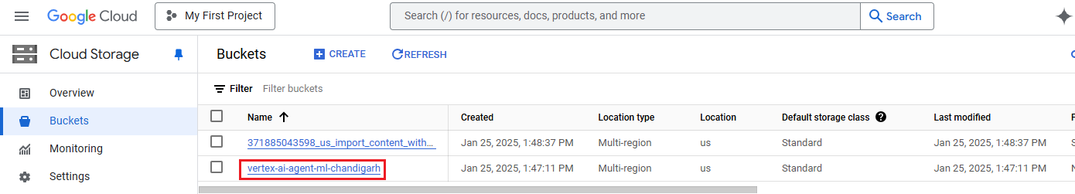
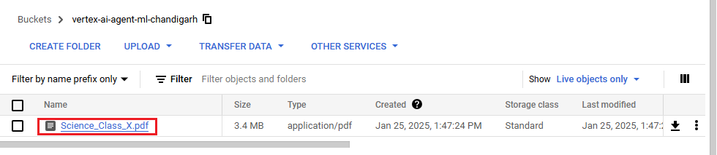
Hands-on with Vertex AI Agent Builder: Chat App
Step 1: Create a bucket in Cloud Storage.
Step 2: Add file(s) in the bucket.

Slide 21
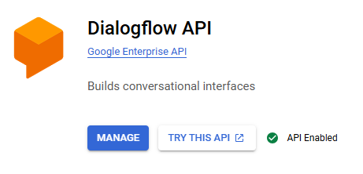
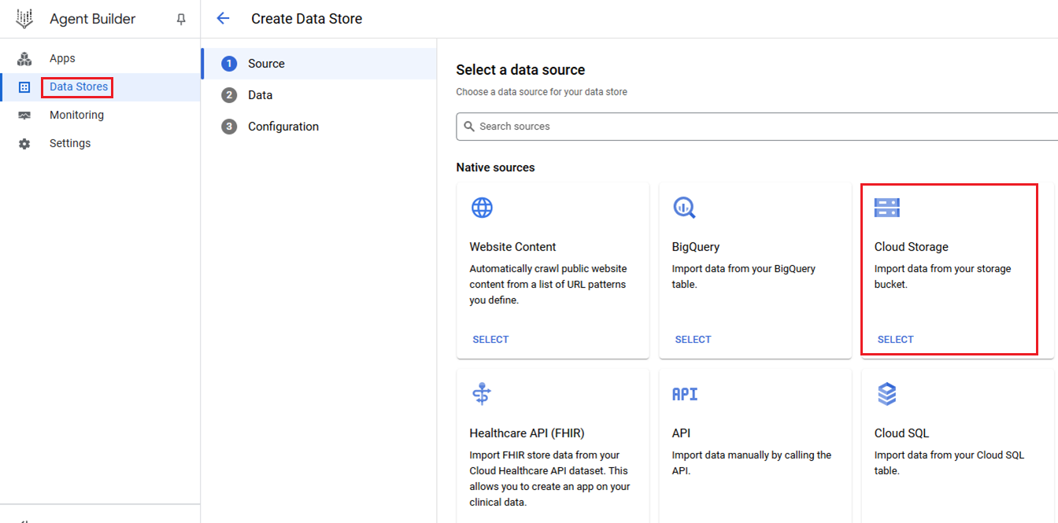
Step 3: Go to APIs & Services → Enabled APIs & Services → Search for Dialogflow API and enable it.
Step 4: Open Vertex AI Agent Builder → Data Stores → Create Data Store → Cloud Storage.

Slide 22
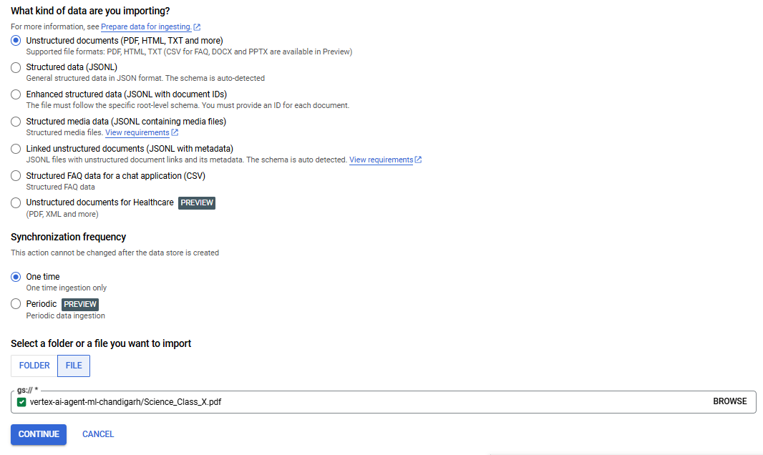
Step 5: Import file from GCS (saved during step 2).

Slide 23
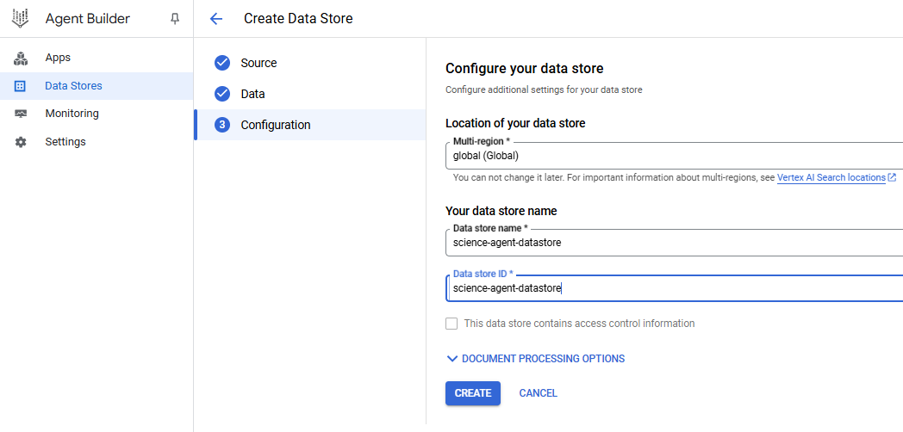
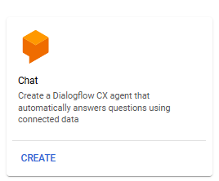
Step 6: Create and configure the Data Store.
Step 7: Go back to Agent Builder → Create a new Agent App → Choose “Chat” App.

Slide 24
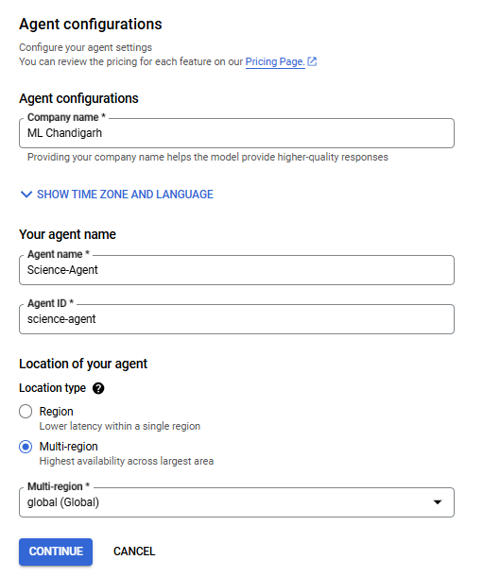
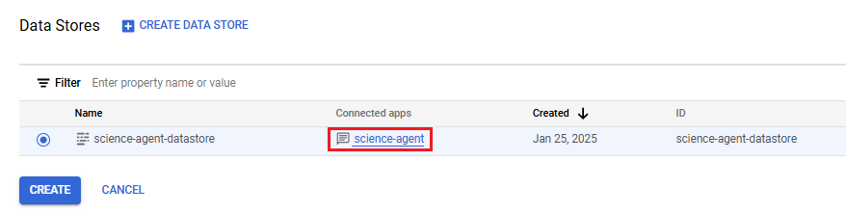
Step 8: Configure the Agent by providing agent name, location, etc.
Step 9: Connect Data Store with Agent.

Slide 25
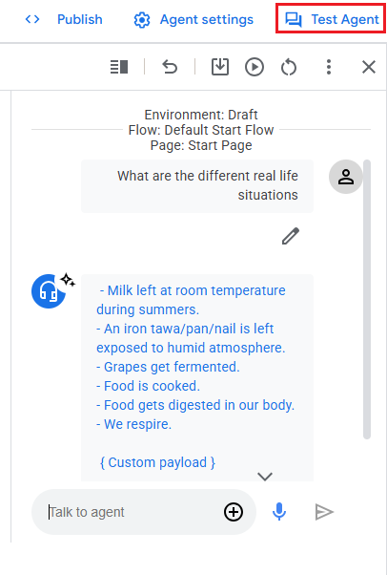
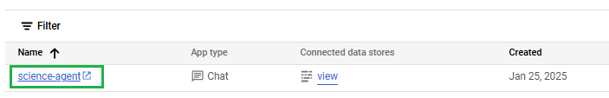
Step 10: Finally, test the AI Agent you’ve built.
Click on the agent name, a new window opens for Dialogflow

Slide 26
We’re excited to see what you build with AI Agents.
Share on Twitter (X) and mention @TFUGChandigarh @NSTiwari21

Slide 27
Resources

Slide 28
Resources
Google’s Whitepaper on AI Agents: https://archive.org/details/google-ai-agents-whitepaper
SmolAgents by Hugging Face (blog/documentation): https://huggingface.co/docs/smolagents
SmolAgents GitHub repository: https://github.com/huggingface/smolagents
Vertex AI Agent Builder: https://cloud.google.com/products/agent-builder
Session resources (Colab notebook and dataset): https://github.com/NSTiwari/ML-Chandigarh-AI-Agents

Slide 29





Thank You.
linkedin.com/in/tiwari-nitin
medium.com/@tiwarinitin1999
twitter.com/@NSTiwari21
github.com/NSTiwari

